Slide 1


Paysafe Post-Campaign Analysis
Review of the Most Recent per Merchant Marketing Campaign

Slide 2
Campaign Details
In February 2018 Paysafe started a new per merchant marketing campaign - a sing-up bonus of three deposits out of charge for new registrations through the merchant website.
Initially four merchants were launched and a fifth one (Betunfair) was added later in March (27/3/2018). To sign up an account every customer should:
1. Click on the ad
2. Click on ‘Register’
3. Fill in the sign-up form and complete the registration

Slide 3
Analysis Objectives
Calculate
Calculate the sign-up rate by month and explore which months were below the period average
Explore
Explore the factors that drive the decrease in those months and what the observed trends show
Predict
Predict what the expected campaign sign-up rate for September would be given that the views on site for Bet180 are likely to increase by 30%

Slide 4

Data Cleaning
As already mentioned, Betunfair was added to the campaign in 27th of March which means that we have to calculate the approximate amount for the whole month, given the total number for the last 5 days of the month. We can measure that by using the following formula:
Total amount for 27-31st of March = x
Whole month = x/5*31
The campaign was running till 14th of August which means that we have to predict what the full month would look like, based on the information we have for the first 14th days of the month. We can follow the same logic as above.

Slide 5
Campaign Statistics
Month | Registered Views | Total Views on Site | Sign-up Ratio | Average Ratio | Below Average
March | 184,307 | 1,047,466 | 0.176 | 0.212 | Yes
April | 384,863 | 1,504,933 | 0.256 | 0.212 | No
May | 478,190 | 1,832,093 | 0.261 | 0.212 | No
June | 145,712 | 1,112,342 | 0.131 | 0.212 | Yes
July | 214,247 | 1,046,910 | 0.205 | 0.212 | Yes
August | 206,701 | 1,014,205 | 0.204 | 0.212 | Yes
Based on this information, we can conclude that March, June, July and August have sign-up ratios that are below the average for the period. We observe a huge drop in June thus more in-depth analysis of this month is needed in order analyse the factors behind this drop and check for any discrepancies.

Slide 6
Factors Behind the Decrease
Month | Registered Views | Total Views on Site | Sign-up Ratio | Average Ratio | Below Average
March | 184,307 | 1,047,466 | 0.176 | 0.212 | Yes
April | 384,863 | 1,504,933 | 0.256 | 0.212 | No
May | 478,190 | 1,832,093 | 0.261 | 0.212 | No
June | 145,712 | 1,112,342 | 0.131 | 0.212 | Yes
July | 214,247 | 1,046,910 | 0.205 | 0.212 | Yes
August | 206,701 | 1,014,205 | 0.204 | 0.212 | Yes
By looking at the campaign statistics, we can conclude that April and May were strong months which is a sign for seasonality. Those two high months increase the average and which make the rest of the months below the average.

Slide 7
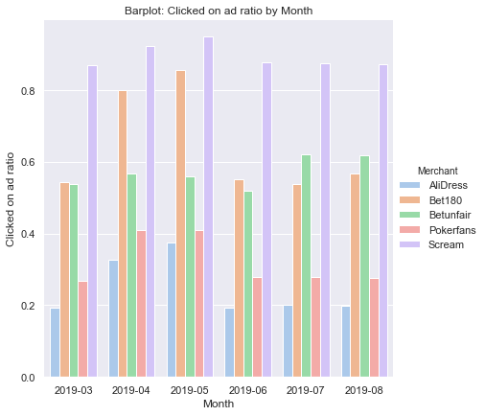
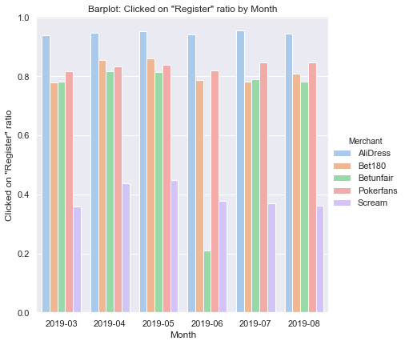
Factors Behind the Decrease cont
When analysing the conversion rates by month at each one of the steps, we observe a big drop in the clicked on ‘register’ ratio for Betunfair in June. It seems like there was an issue which was fixed in July. We also observe the lowest clicked on ad rate for Betunfair again in June, compared to the rest of the months. So, the data for this month and this merchant needs to be cleaned first, before moving on to the next part of the analysis.*
* The calculations are attached in the appendix

Slide 8
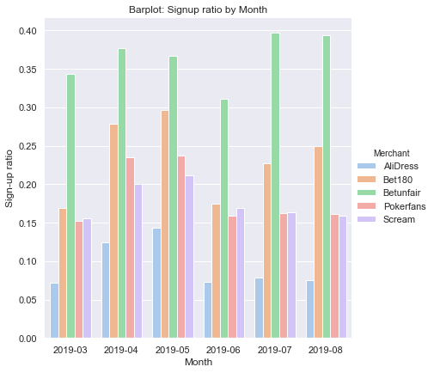
Factors behind the Decrease cont.
The updated graph is showing the new sign-up rate(completed registrations over total views on site) after revising the data for Betunfair in June.
We can see that Bet180 has a trend of increasing for the last three months. We are exploring the ratio in each individual step in the next slide.

Slide 9
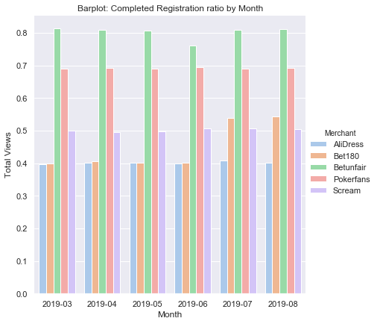
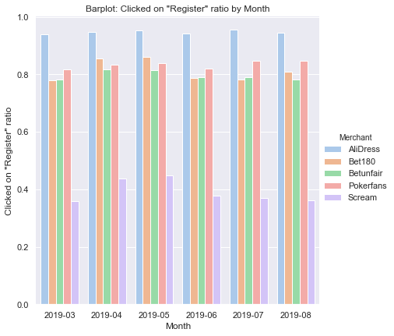
Factors behind the Decrease cont.
The updated graphs is showing are showing the sign-up ratio at each individual step.
We can see that the increase in the overall sign-up rate for Bet180 is due to an increase of the ratio in all of the steps but the most significant one is in the last step – complete registration ratio(people who registered out of those who clicked on register):
Months | Merchant | Clicked on ad ratio | Clicked on register ratio | Complete Reg ratio
June | Bet180 | 0.55 | 0.78 | 0.40
July | Bet180 | 0.54 | 0.78 | 0.53
August | Bet180 | 0.57 | 0.80 | 0.54

Slide 10
Factors behind the Decrease cont.
Month | Merchant | Click on the advert ratio
March | Scream | 0.87
April | Scream | 0.92
May | Scream | 0.95
June | Scream | 0.88
July | Scream | 0.88
August | Scream | 0.87
Month | Merchant | Click on ‘Register’ ratio
March | Scream | 0.36
April | Scream | 0.44
May | Scream | 0.45
June | Scream | 0.38
July | Scream | 0.37
August | Scream | 0.36
Also, the click on ad ratio for Scream is very high across the whole period, however the average of less than 40 % of the people who clicked on the ad, click on register as well. Whereas, we can see that the rest of the merchants have much higher click on reg ratio – with an average of 80%.

Slide 11
Solutions
-Testing if the target audience is correctly identified
-Comparing different ad designs and see which one is the most appealing to the target audience
-Check for any technical issues
A/B testing is a good solution for:

Slide 12
Given that the views on site for Bet180 are likely to increase by 30%, what the sign-up ratio for September would be?
Month | AliDress | Betunfair | Bet180 | Scream | Pokerfans
March | 0.07 | 0.34 | 0.16 | 0.15 | 0.15
April | 0.12 | 0.37 | 0.28 | 0.20 | 0.23
May | 0.14 | 0.36 | 0.29 | 0.21 | 0.23
June | 0.07 | 0.31 | 0.17 | 0.16 | 0.15
July | 0.07 | 0.39 | 0.22 | 0.16 | 0.16
August | 0.07 | 0.39 | 0.24 | 0.15 | 0.16
If the views for Bet180 rise with 30%, the sign up ratio is going to become 0.26 for this merchant (see the calculations in the appendix). For the rest of the merchants, we will take a look at the last 3 months as they represent the most recent trend as April and May are strong months which show seasonality in the data which is not a applicable for September. Then, we can calculate the average the rest of the merchants. For AliDress it is - 0.07, for BetunFair we will take 0.39 as June was affected by the technical issue, for Scream – 0.16 and for Pokerfans – 0.16. When we take the mean of the sign up rates for each of the merchants, the result is 0.202 or 0.2.

Slide 13
Task 2:
User Testing - The Importance of Understanding and
Connecting with your Customers
UserTesting is a platform for getting rapid customer feedback on almost any customer experience existing, including websites, mobile apps, prototypes, and real world experiences. Audio and Video recordings of real people are provided that are part of the target market speaking their thoughts as they complete the specified tasks. My idea is to use this service in order to get accurate feedback from the consumers using Skrill and NETELLER.. With continuous user feedback, Paysafe can:
Identify pain points in the customer experience
Understand what the customers are thinking and feeling
Validate design decisions before committing resources
Influence stakeholders to make improvements

Slide 14
Task 2 cont.
Understand the complete user experience with these following methodologies:
Focus groups
A/B testing – for both wallets we can do A/B testing on some of the features of the wallets or on the user experience as a whole.
Demographic survey. It’s good to know who the customers using Skrill and NETELLER are.
Cancel survey. When customers cancelled or stopped using the product in our case, our consumer wallets Skrill and NETELLER. We can ask them why they left. This gave us a trend line — if an issue spiked over time, we would address it quickly.

Slide 15
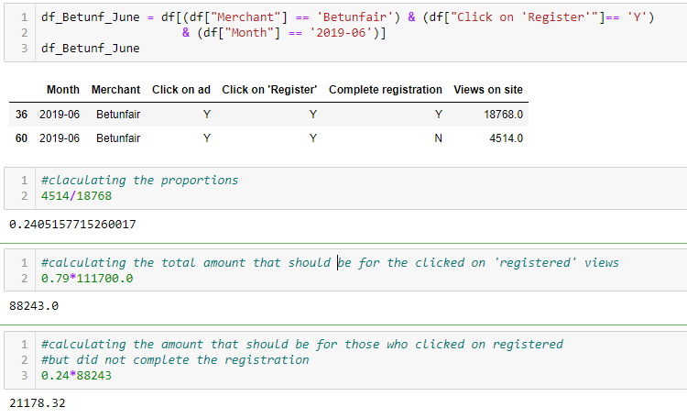
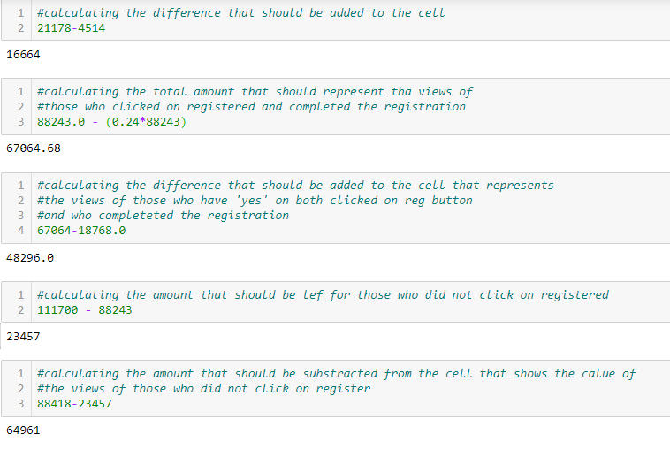
Appendix:
https://github.com/ckusheva/Post-Campaign-Analysis
Cleaning the Betunfair data for June:
Calculating Bet180 sign-up ratio for September:
Calculate the total views
Calculate the conversion rate of each stage
Multiply the three rates to calculate the final sign – up rate (registered views divided by total views of the merchant)
280419*1.3 = 364544
(364544*0.54)*(364544*0.54*0.79)*(364544*0.54*0.79*0.55) = 0.26

Slide 16

Thank you!

